Slide 1
Natural Language To SQL Generator
Team Details
P. Neetha Reddy (20EG105435)
M. Surya Teja (20EG105423)
Project Supervisor
B. Ravinder Reddy (Assistant Professor)

Slide 2
Introduction
Querying database through Structured Query Language(SQL) require knowledge in the field, hindering the accessibility for individual without expertise in the field. The challenges faced by Natural Language to SQL generator models, particularly in handling extensive datasets, have been a point of concern. These models, designed to simplify database interactions, often encounter inaccuracies due to limitations in their training data.
For the development of the model utilizes a novel dataset that consists of the user inputs and its corresponding queries. OpenAI API key is used to access the OpenAI’s Large Language Models, and Python IDLE used for developing the model.
The application of this SQL query generator extends to individuals without expertise in the field required. It is useful to generate complex queries and is efficient to work with extensive datasets.

Slide 3
Problem Statement
The barrier of learning programming languages for retrieving information from extensive databases. Existing methods often compromise on accuracy and struggle with managing large databases. The goal is to create an efficient text-to-SQL generator that enables users to interact with sizable databases without the need for extensive programming knowledge, ensuring both accuracy and scalability.

Slide 4
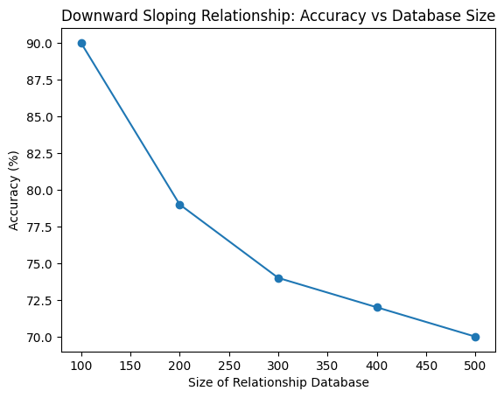
Problem Illustration
In the existing approaches, as the size of a database grows, the increased variability in the data may result in lower accuracy. The usage of more number of tables leads to less accurate results and increases the time of execution.
Accuracy problem in existing approaches
No of tables | No of tuples | Accuracy | Avg time of execution
1 | 240 | 0.825 | 2 ms
2 | 765 | 0.714 | 46 ms
5 | 1864 | 0.641 | 108 ms
8 | 7642 | 0.584 | 193 ms

Slide 5
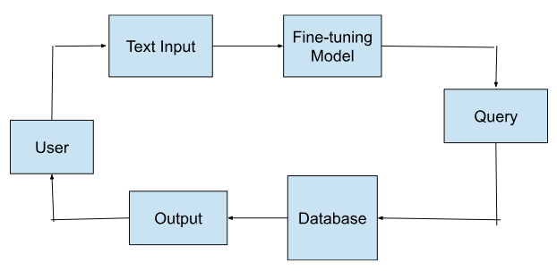
Proposed Method
It consists of 4 phases:
User Input - The schema and question are provided.
Processing - SQL query is generated based on the input.
Accessing database - The output is generated based on the query for the provided input.
Result - The output is displayed for the user.

Slide 6
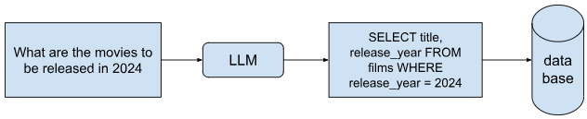
Proposed Method Illustration
The input provided by the user, is processed by the LLM to generate the SQL query, which is executed against the database to obtain the required information.

Slide 7
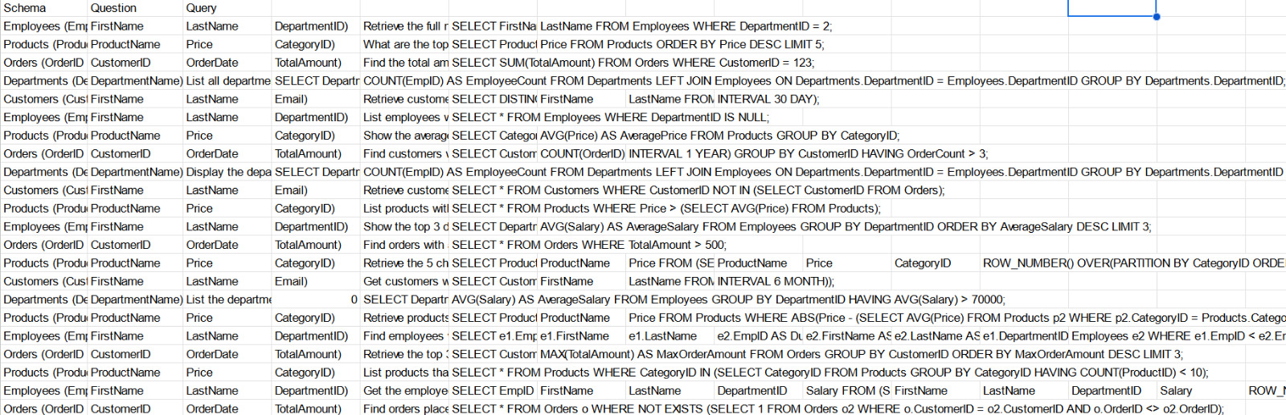
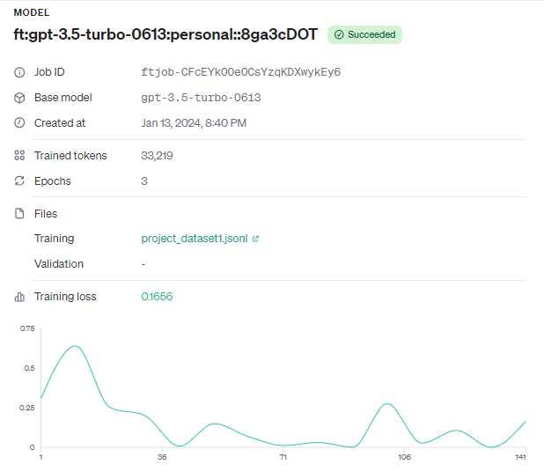
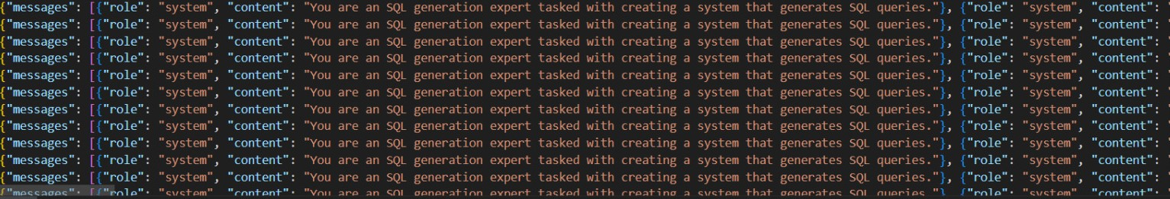
Experiment Environment
A fine-tuned model was created using an OpenAI API key and the dataset. The OpenAI API key is utilized to access the Large Language Model (LLM) of OpenAI, and the dataset is converted into JSON Lines files, which are further utilized in fine-tuning.
Dataset
Converted
Details of fine tuned model
JSONL Dataset

Slide 8
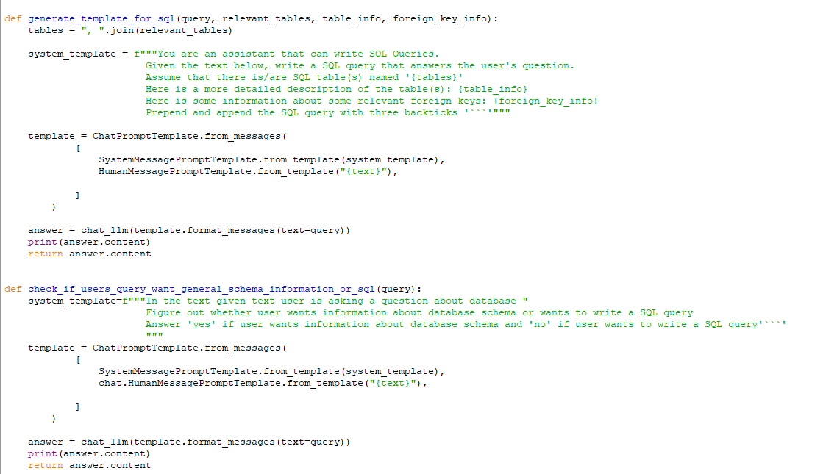
Experiment Environment
Following Libraries are used:
OpenAI: Installed to access OpenAI's
models for SQL Generation.
LangChain: Essential for Generating the queries.
Chroma: Helps in vector representation of the CSV files.
.
CSVLoader: Helps for loading the data from the CSV files.
Psycopg2: Helps to establish a connection with the database server.
Experiment Environment used is Python IDLE

Slide 9
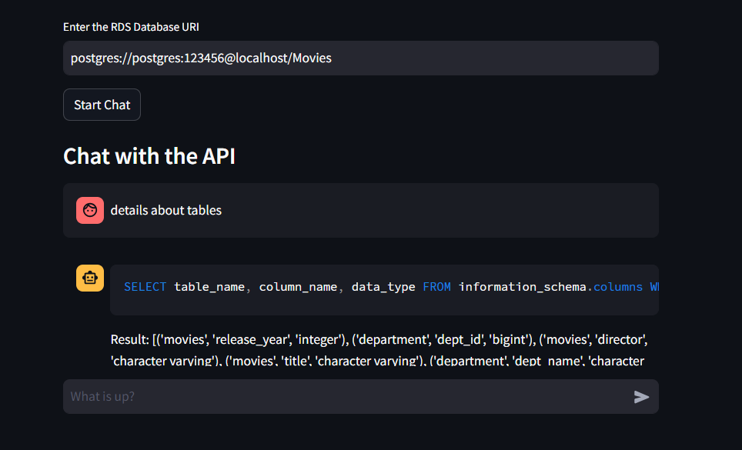
Experiment Environment
Python IDLE is used to create user interface using streamlit
Python IDLE
User Interface

Slide 10
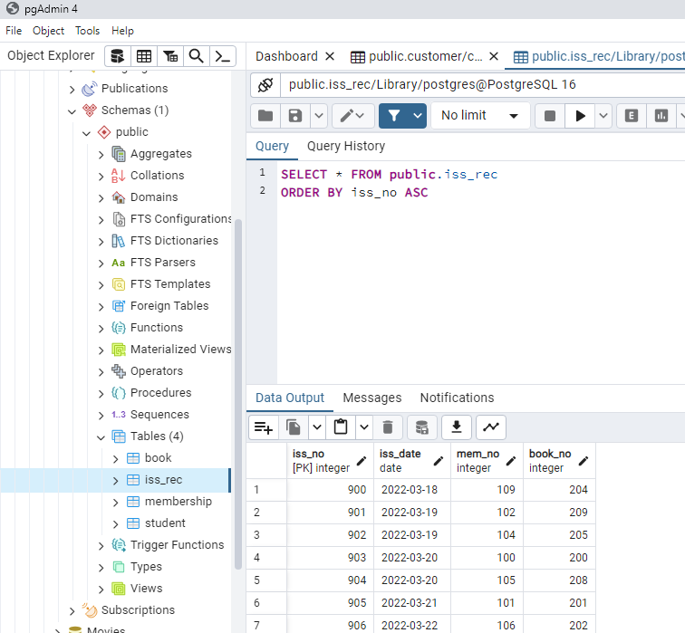
Experiment Environment
Database

Slide 11
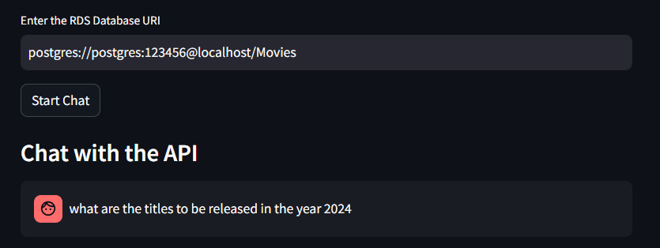
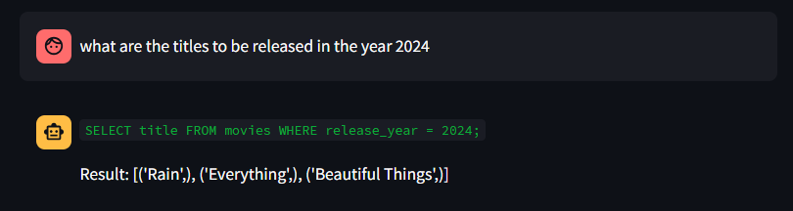
Experiment Screenshot
For the experiment, we will select one question along with its corresponding query from testing data and conduct SQl Generation using proposed method.
Question and Database link Query

Slide 12
Experiment Screenshot
Input: Database link and question.
Output: SQL Generation
Input
Output

Slide 13
Experiment Results
An experiment was conducted generating 50 queries using the proposed model and the existing model. The numbers below represent the average scores obtained by generating 50 queries.
Experiment Results
Parameters | Existing Method | Proposed Method
Precision Score | 0.73 | 0.87
Execution Accuracy | 0.76 | 0.89
Semantic Accuracy | 0.86 | 0.92

Slide 14
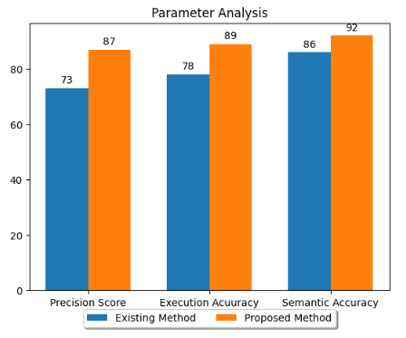
Experiment Results
Experiment analysis between Existing Method and Proposed Method

Slide 15
Finding
The proposed method effectively generates queries for varying tables and datasets.
The model proficiently produces concise queries by capturing all the semantics.
Through fine-tuning, the model generates queries that help to interact with the databases.
A high precision score shows that the machine-generated queries captures the essence of natural language from the reference queries.
In comparison to existing methods, the proposed method generates more executable queries.

Slide 16


Justification
Parameters | Mathematical Formula | Existing Value | Improved Value | Justification
Precision Score |  | 0.73 | 0.87 | OpenAI’s Large language model is trained with high quality dataset.
Execution Accuracy |  | 0.78 | 0.89 | LLM model accurately captures the essence of the natural language.
Semantic Accuracy |  | 0.86 | 0.92 | LLM model accurately captures the semantics of the natural language.

Slide 17
Thank You

